Slide 1
TEAM : CYGNUS
TEAM MEMBERS:
KUNWAR PRATAP SINGH
AKRITI SHARMA
KARNIK KUMAR
AMRITJOT SINGH

Slide 2
PROBLEM STATEMENT
In day-to-day life, we see so many public accommodations which are in bad condition and these accommodations remain broken or ill-maintained due to many reasons, one of which is lack of awareness and ill-managed complaint process. Similarly, this happens on college campuses too. There are so many deformities in so many areas but college authority doesn’t know about this as they aren’t aware of that issue.

Slide 3
PROPOSED SOLUTION
We are designing a platform in which a user can update us about the ill-maintained accommodation that they have seen on campus by clicking the pic of that object along with the small description of that problem and uploading it on our website.
After uploading we will verify in which department this issue comes under and we will notify that department to take necessary action and the user get acknowledgment about it.
Once the issue is resolved the user will get acknowledged.
We will also add a chatbot to automate the process of filing a complaint and FAQs

Slide 4
TECHNOLOGY USED
Html
CSS
JavaScript
Django
Python

Slide 5
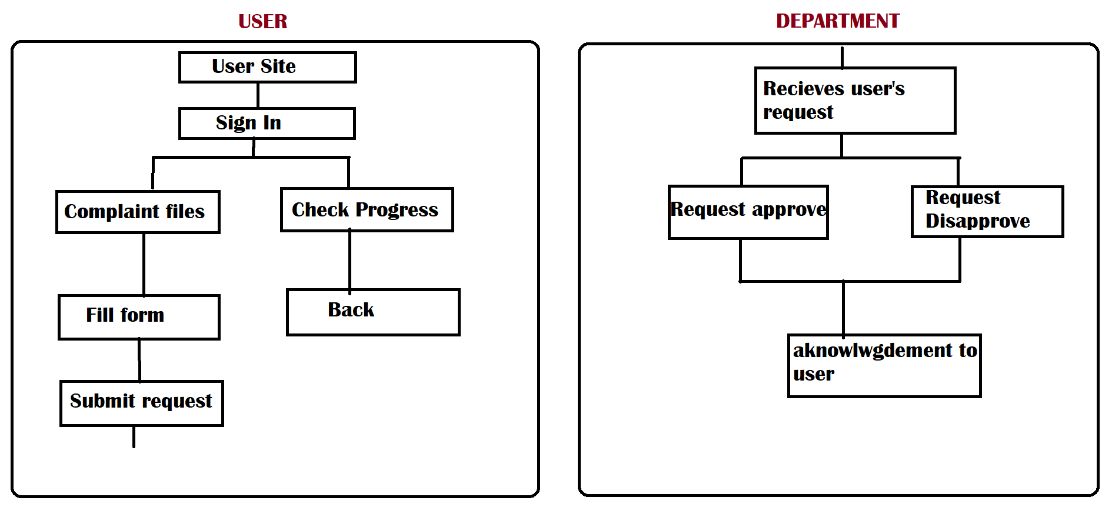
Approach

Slide 6
Scalability
This platform is for chitkara campus for now but it can also be scalable to all other colleges as there are so many college where students are facing the same issue.
Further more once this platform is successful for colleges then we can shift to district level too.
And as our technology advances we can further make this platform for very large level which is country level.

Slide 7
WHAT POSITIVE AND UNIQUE SOLUTIONS DOES OUR IDEA HAVE?
We are modernizing the conventional complaint system.
There will be transparency and efficiency in the complaint system

Slide 8
THANK YOU

